Slide 1
Authentication, Authorization, and JWT
SoftUni Team
Technical Trainers
Software University
https://softuni.bg

Slide 2
Table of Contents
JWT
Authentication and Authorization
2

Slide 3
Have a Question?
sli.do
#Flask

Slide 4
JSON Web Tokens
JWT

Slide 5
JWT
JSON Web Tokens (or JWTs) provide a means of transmitting information from the client to the server in a stateless, secure way.
Generated by signing user information via a secret key

Slide 6
JWT
Client provides email and password, which is sent to the server
Server then verifies that email and password are correct and responds with an auth token
Client stores the token and sends it along with all subsequent requests to the API
Server decodes the token and validates it
This cycle repeats until the token expires or is revoked. In the latter case, the server issues a new token

Slide 7
Example
pip install pyjwt
def encode_token(self):
try:
payload = {
'exp': datetime.utcnow() + timedelta(days=2),
'sub': self.id
}
return jwt.encode(
payload,
key=config('SECRET_KEY'),
algorithm='HS256'
)
except Exception as e:
raise e

Slide 8
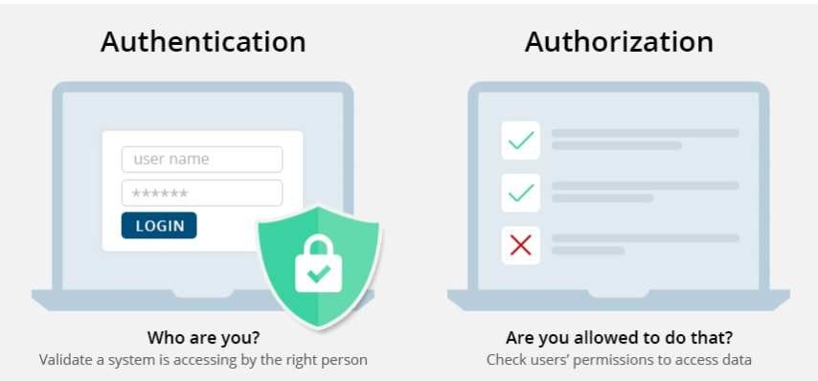
Authentication and Authorization

Slide 9
Definition (1)
While authentication and authorization are often used interchangeably, they are separate processes used to protect an organization from cyber-attacks
As data breaches continue to escalate in both frequency and scope, authentication and authorization are the first line of defense to prevent confidential data from falling into the wrong hands
As a result, strong authentication and authorization methods should be a critical part of every application's overall security strategy

Slide 10
Definition (2)
Authentication is the process of verifying who someone is
Authorization is the process of verifying what specific applications, files, and data a user has access to
Authentication works through passwords, one-time pins, biometric information, and other information provided or entered by the user
Authorization works through settings that are implemented and maintained by the organization

Slide 11
Definition (3)
Authentication is the first step of a good identity and access management process
Authorization always takes place after authentication
Authentication is visible to and partially changeable by the user
Authorization isn’t visible to or changeable by the user

Slide 12
Example in Flask
from flask_httpauth import HTTPTokenAuth
auth = HTTPTokenAuth(scheme='Bearer')
@auth.verify_token
def verify_token(token):
try:
user_id = User.decode_token(token)
return User.query.filter_by(id=user_id).first()
except Exception:
return 400

Slide 13
Example in Flask (2)
class ClothesRouter(Resource):
@auth.login_required
def get(self):
current_user = auth.current_user()
clothes = Clothes.query.all()
return {"data": clothes}, 200

Slide 14
Example in Flask (3) - Authorization
def permission_required(permission):
def decorator(f):
def decorated_function(*args, **kwargs):
user = auth.current_user()
if not user.role == permission:
abort(403)
return f(*args, **kwargs)
return decorated_function
return decorator

Slide 15
Example in Flask (4) - Authorization
class ClothesRouter(Resource):
@auth.login_required
@permission_required(is_admin)
def get(self):
current_user = auth.current_user()
clothes = Clothes.query.all()
return {"data": clothes}, 200

Slide 16

Live Demo

Slide 17
Questions?
Notes:
17

Slide 18












SoftUni Diamond Partners

Slide 19


Educational Partners

Slide 20
Trainings @ Software University (SoftUni)
Software University – High-Quality Education, Profession and Job for Software Developers
softuni.bg, softuni.org
Software University Foundation
softuni.foundation
Software University @ Facebook
facebook.com/SoftwareUniversity
Software University Forums
forum.softuni.bg
20
Notes:
20

Slide 21

License
This course (slides, examples, demos, exercises, homework, documents, videos and other assets) is copyrighted content
Unauthorized copy, reproduction or use is illegal
© SoftUni – https://softuni.org
© Software University – https://softuni.bg
Notes:
21

